Slide 1
Model Building
Using Word2Vec NLP & Scikit-Learn Libraries
Jeremy Bergmann - Omaha Data Science Academy

Slide 2
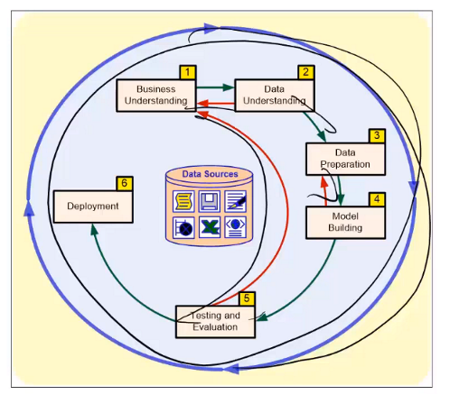
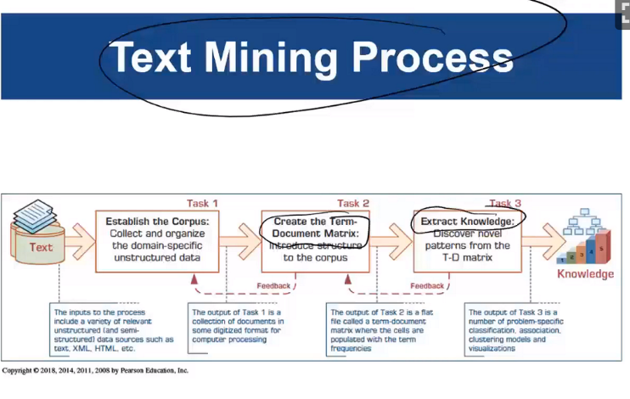
Text Mining & NLP Recap
CRISP-DM Process - The CRISP-DM process outlines the steps involved in performing a data science project, from business need to deployment.
Also, it indicates that data science is an iterative process that requires continual evaluation and improvement.
Text Mining - Similar to Data Mining, which is the “non-trivial process of identifying valid, novel useful and understandable patterns” in unstructured, text-based data sources.
Notes:
Unstructured data - information that either does not have a pre-defined data model or is not organized in a pre-defined manner. Unstructured information is typically text-heavy, but may contain data such as dates, numbers, and facts as well. (80-90% of firm’s data)

Slide 3
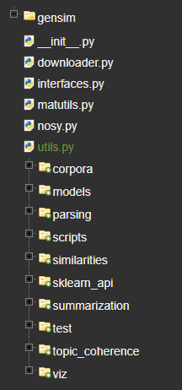
Gensim Word2Vec Package
Package Contents
Data Prep: Corpora and Vector Spaces
Data Understanding: Similarity Queries
Model Building: Topics and Transformations
Model Deployment: Distributed Computing
Model Documentation https://radimrehurek.com/gensim/tut2.html#available-transformations
Notes:
Key difference is in goal - grouping/classification (text mining) vs. meaning & context (NLP)
NLP Introduction: https://blog.algorithmia.com/introduction-natural-language-processing-nlp/

Slide 4
Data Prep
Package Contents
Data Prep: Corpora and Vector Spaces
Data Understanding: Similarity Queries
Model Building: Topics and Transformations
Model Deployment: Distributed Computing
Model Documentation https://radimrehurek.com/gensim/tut2.html#available-transformations
Notes:
Key difference is in goal - grouping/classification (text mining) vs. meaning & context (NLP)
NLP Introduction: https://blog.algorithmia.com/introduction-natural-language-processing-nlp/

Slide 5
Data Understanding
Package Contents
Data Prep: Corpora and Vector Spaces
Data Understanding: Similarity Queries
Model Building: Topics and Transformations
Model Deployment: Distributed Computing
Model Documentation https://radimrehurek.com/gensim/tut2.html#available-transformations
Notes:
Key difference is in goal - grouping/classification (text mining) vs. meaning & context (NLP)
NLP Introduction: https://blog.algorithmia.com/introduction-natural-language-processing-nlp/

Slide 6
Model Building
Model Documentation https://radimrehurek.com/gensim/tut2.html#available-transformations
Word2Vec NLP Models (Input Vectors)
Term Frequency * Inverse Document Frequency, Tf-Idf (Bag-Of-Words)
Intended to reflect how important a word is to a document in a collection or corpus
Latent Semantic Indexing, LSI (or sometimes LSA) (Bag-of-words/tfldf-weighted space)
LSI is being used in a variety of information retrieval and text processing applications, although its primary application has been for concept searching and automated document categorization
Random Projections, RP (tfldf-weighted space)
Powerful method for dimensionality reduction “Simplifiying Data”
Latent Dirichlet Allocation, LDA (Bag-Of-Words)
Allows sets of observations to be explained by unobserved groups that explain why some parts of the data are similar
Hierarchical Dirichlet Process, HDP (Bag-Of-Words) - Experimental Use

Slide 7
Gensim Word2Vec to Scikit-Learn
Purpose:
Re-factor Gensim Model to utilize Scikit-Learn features.
Improved usage when integrating with Jupyter Notebooks & Dataiku
Improved Data Understanding and Model Performance
Model Deployment
Steps:
Port/Generalize code by utilizing the “sklearn_api” library within Gensim.
Leverage SciKit-Learn data exploration packages and graphical libraries.
Leverage SciKit-Learn data transformations, models and model selection packages.
Improved Portability w/Dataiku

